Slide 1
Introduction of SQA
SQA: Manual & Automated Testing

Slide 2
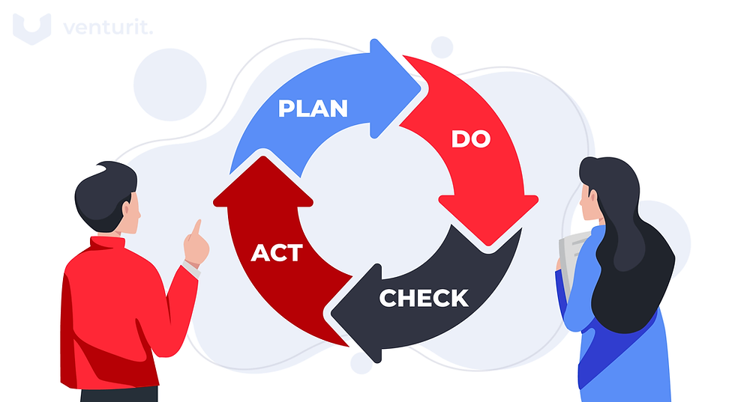
SQA (Software Quality Assurance)
Systematic process in every phase of development.
Evaluates processes, methodologies, and tools
Helps to ensure -
  Defect Prevention
  Quality Management
  Continuous Improvement

Slide 3
Understanding software testing
The economic importance of software
  The functioning the machines and equipment depends largely on software
  Can't Imagine large systems in telecom, finance or traffic control without software.
Software quality
  The quality of the software has become the determining factor for the success of any technical or commercial systems and products
Testing for quality improvement
  Testing and reviewing ensures the improvement of the quality of software products as well as the quality of software development process itself.

Slide 4
Why SQA/Testing is important?
Saves money
Ensures security
Maintains the Quality of the product
Confirms Satisfaction of the consumer
Enhances the development technique
Easy even as adding new capabilities
Determines the performance of the software program

Slide 5
Real Life Example-1
Knight Capital Group was one of the top financial trading company is USA.
A costly software mishap that led to one of the most expensive trading losses ever.
In their routine update triggered unintended high-speed trades, resulting in over $440 million in losses within 40-45 minutes.
It had a huge impact in the stock market
It became bankrupt within a week

Slide 6
Real Life Example-2
Lethal X-Rays - Therac-25 incidents: Because of a software failure a number of patients received radiation doses hundreds of times greater than intended between 1985 and 1987:
  Therac-25 was a radiation therapy machine produced by atomic Energy of Canada Limited.
  It was involved with at least six known accidents between 1985 and 1987, in which patients were in some cases on the order of hundreds of gray. At least five patients died of the overdoses.
  The timing of operator input was critical. If operators typed certain commands or corrected input quickly, the software might not complete safety checks or wait for hardware components to align or confirm state. This race condition could allow a high-energy beam to fire when it shouldn’t.
  These accidents highlighted the dangers of software control of safety-critical system.
Source: Wikipedia.com

Slide 7
SQA Roles
SQA Engineer
QA Automation Engineer
Tester
Lead SQA
QA Manager
Automation Analyst
QA Analyst
Test Analyst

Slide 8
Career Path
QA Engineer / Tester
Test Analyst / QA Analyst
Sr Tester / QA Analyst
Jr QA/ QA Intern
QA Automation Engineer
Automation Analyst
Sr Automation Analyst

Slide 9
Career Path
Sr Tester / Sr QA Analyst
SQA Lead
QA Manager
Project Manager
Sr Automation Analyst
Devops Engineer
Security Engineer

Slide 10
SQAE’s Responsibilities
Connectivity Between Stakeholders and Development Team
Promoting the User Experience
Ensuring Process Optimization and Improvement
Risk Reduction and Management
Maintaining Regulatory Adherence and Compliance
Mentoring and Training Development Teams
Encouraging a Culture of Quality First

Slide 11
Defects, Root Cause Analysis and Effects
"An ounce of prevention is worth a pound of cure". In SQA context, it means that it gets more expensive to fix the defects if they remain for long in a process.
So Root Cause Analysis (RSA) is required to find the causes of problems to provide appropriate solutions.
What is Root Cause Analysis?
Why Defect Occurs?
How is Root Cause Analysis Done?
Examples of Root Cause Analysis

Slide 12
What is Root Cause Analysis?
RCA is a systematic approach to identifying the underlying causes of an incident.
It helps in taking appropriate steps, so the problem is addressed.
In an ideal world, the software should have Zero defects, and it should not show any failure. Practically, it's never possible.
By effective QA processes, it can be ensured that the software has minimum defects. Also it can be ensured that the right techniques are followed to find the underlying cause of any defect.
This process of identifying WHY the problem has occurred in the software is called Root Cause Analysis (RCA)

Slide 13
What is Root Cause Analysis?.. Cont.
The root cause analysis is like a chain of events that go backward.
It starts from the last possible action to the previous one, so on and so forth.
It continues until it reaches the beginning of the problem. Hence, it's called reverse engineering.
The easiest way to understand root cause analysis is to think about everyday problems. If we are sick, we will go to a doctor and ask them to look for the cause of our illness. To solve or analyze a problem, we will need to perform a root cause analysis and find out specifically what the reason is and how to solve it.

Slide 14
Why Defect Occurs?
Inadequate requirements
Programming errors
Communication gap
Time Pressures
Inappropriate environment

Slide 15
How to do Root Cause Analysis?
Root Cause Analysis is a 4 step process. We need to ask 4 Questions that will summarize the RCA process:
What?
When?
Why?
How?

Slide 16
Examples of Root Cause Analysis
The Disney company launched its first multimedia CD-ROM game for children, "The Lion King Animated Storybook", in the fall of 1994. And the sales were huge.
On December 26, Disney customer service phones began ringing, ringing, and ringing.
The defected software didn’t work on a top-rated PC platform. It turns out that Disney could not test the software in different PC models available in the market. The software worked on a few systems that Disney programmers probably used to create the game.
The company found the root cause of the problem was that the software didn't work on a top-rated PC platform. Testing the software on the top 5 platforms that the consumers used, could have have save this

Slide 17

Any Questions?
Thank you!

